Slide 1

Stage 7 Devil’s Delights Course Designer: Jordan Rogers
Devil’s Delights is a 16 round, 80 point Comstock medium course. There are 6 USPSA targets and 4 steel targets. The best two hits per target will score. Steel must fall to score. The start signal is audible.
The handgun start position is standing outside the shooting area, feet straddling start stick, facing UPRANGE, wrist above shoulders. Handgun is loaded and holstered. The PCC start position is standing outside the shooting area, feet straddling start stick. PCC loaded with stock on belt, muzzle pointing down range.
On the audible start signal, engage targets as visible from with the shooting area. White paper targets are scoring targets, brown targets are no-shoots.

Slide 2
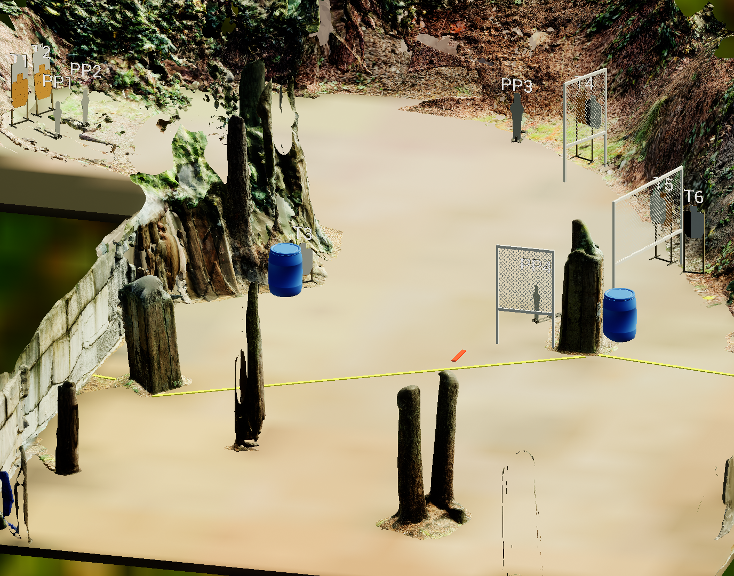
 | Stage 7 Devil’s Delights Course Designer: Jordan Rogers

